Slide 1
Differential Leukocyte Count
Dr.Rasha Naseer Mohammed

Slide 2
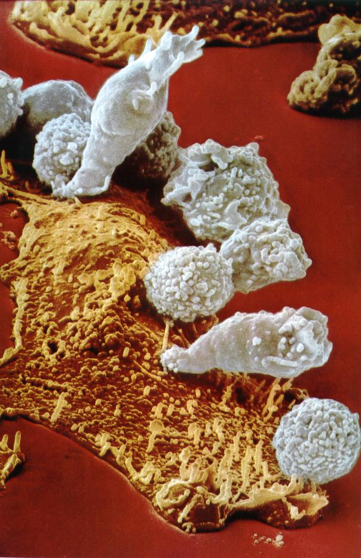
White Blood Cells
4,000 – 11,000/mm³.
produced partially in bone marrow (granulocytes and monocytes)few lymphocytes
And partially in lymph tissue (lymphocytes)
Transported to area of infection: rapid and potent defense
Lifespan of hours to several months
Some make antibodies fight directly.
WBCs have a nucleus and are larger than RBCs

Slide 3
White Blood Cells
Classified by several ways , one type of classification is according to the presence or absence of specific staining granules in the cytoplasm.
Granulocytes
( polymorphonuclear leukocytes)
A granulocytes

Slide 4
Granulocytes
Granulocytes
Neutrophils
Eosinophils
Basophils

Slide 5
Granulocytes
Neutrophils – most numerous WBC
50-70 %
Number 3000-6000 \ mm3
Nucleus : 2-5 lobes
Granules not very amenable to stain :fine pink
Phagocytize and destroy bacteria

Slide 6
Neutrophilia
increase Neu. In blood ex;
1.Acute infection
2.Intoxication
3. inflammation from tissue damage
4.Acute haemorrhage
5.Neoplastic cancer
Drugs??????????

Slide 7
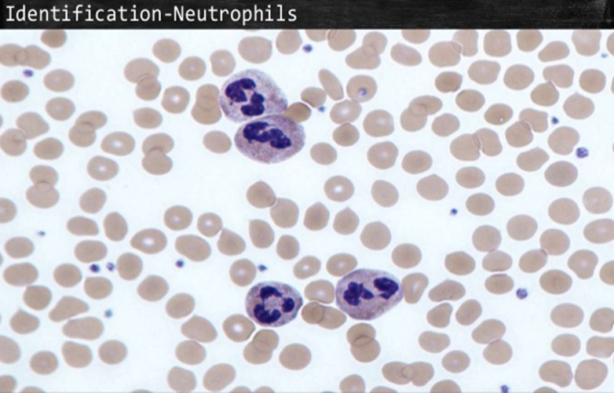

Slide 8
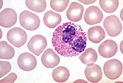
Granulocytes
Eosinophils – compose 1 – 4% of all WBCs
Nucleus: lobulated usually 2-3 lobes
Granules : coarse red color
Play roles in ending allergic reactions, parasitic infections

Slide 9
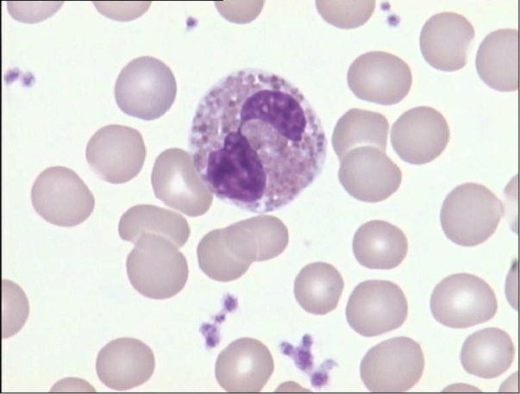

Slide 10
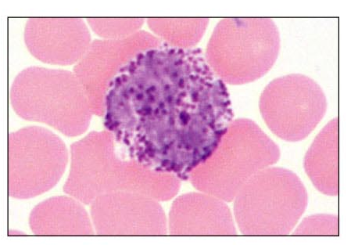
Granulocytes
Basophils – about 0.5-1 % of all leukocytes
A small cell granules are black or blue in color Nucleus – usually two lobes.
Granules secrete histamines
Function in inflammation mediation, similar in function to mast cells
Granules: coarse deep blue (black)

Slide 11
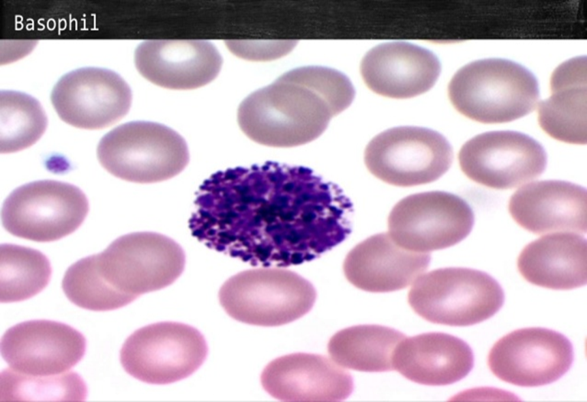

Slide 12
Agranulocytes
A granulocytes
Lymphocytes
Monocytes

Slide 13
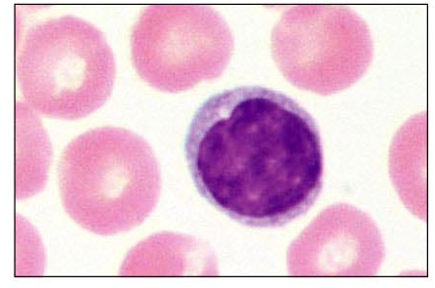
Agranulocytes
Lymphocytes – compose 20 – 40% of WBCs
The most important cells of the immune system
Effective in fighting infectious organisms
Act against a specific foreign molecule (antigen)
Nucleus – equal or larger than the size of RBC, stains dark purple
Cytoplasm scanty – rim cytoplasm
Two main classes of lymphocyte
T cells – attack foreign cells directly
B cells – multiply to become plasma cells that secrete antibodies

Slide 14
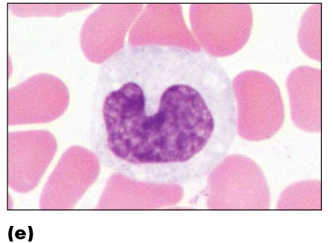
Agranulocytes
Monocytes – compose 2–8% of WBCs
The largest leukocytes( 2-3 times size of RBC)
Nucleus – kidney shaped or rounded)
Cytoplasm : abundant
Transform into macrophages
Phagocytic cells

Slide 15
Disease Case :
Lymphocytosis :increase lymphocyte in blood(Acute infection) ex :Tuberculosis
(chronic infection)ex; viral hepatitis
Monocytosis :ex: Malaria, Typhus, cancer of ovary.

Slide 16
Differential WBC count
4 general steps
Blood smear preparation
fixation
Staning
Counting
reporting

Slide 17
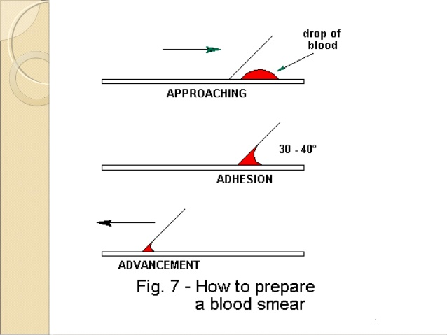
How to prepare blood smear

Slide 18
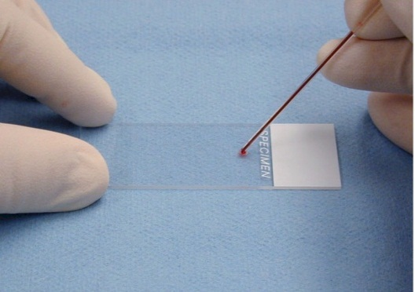
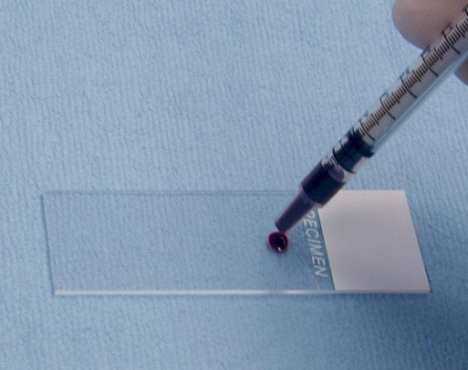
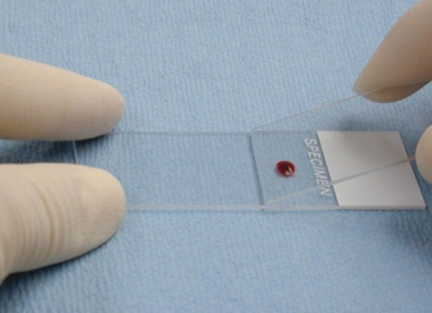
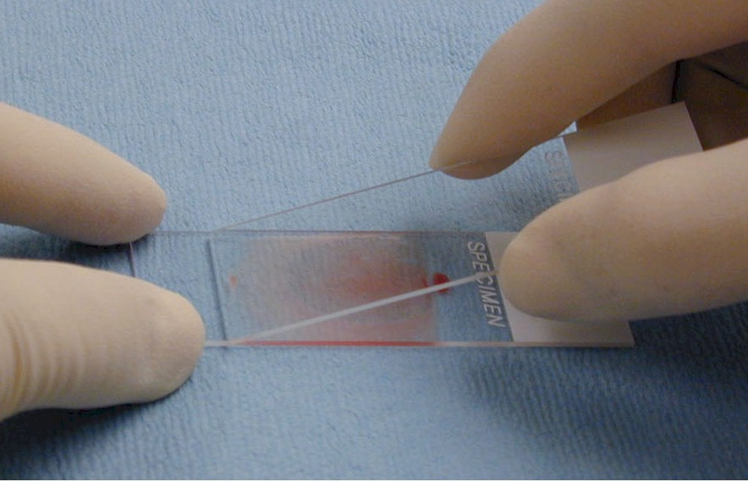
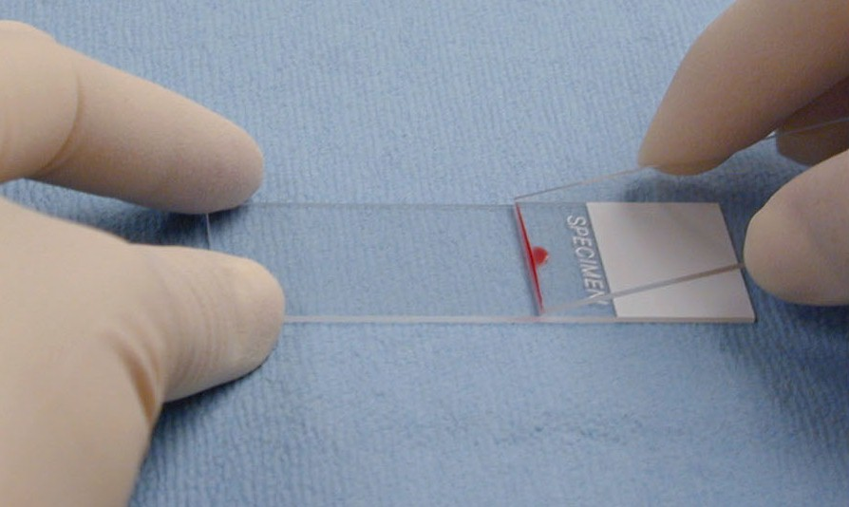
How to prepare blood smear

Slide 19
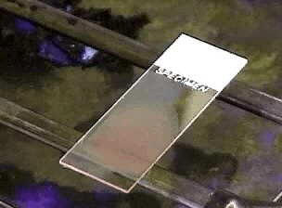
How to prepare blood smear

Slide 20
There are 3 stains that used in differential leukocyte count :
1-Wright stain.
2-Leishman stain .
3-Giemsas stain.

Slide 21
Procedure
Method of staining :
1-Put one drop of blood on the slide leave it for dry
2-Pour Leishman stain(2 drop) over the smear for 5 minutes.
3.Add 2 drop of D.w or buffer solution over the smear for 10 minute.
4-Wash off with Tap water and dry.
The dry and stained film examined without a coverslipe under oil immersion objective(100x) for differential leukocyte counts choose an area where the morphology of the cells is clearly visible.

Slide 22
Counting
Count 100 WBC

Slide 23
N | Neutrophils | Eosinophils | Basophils | Lymphocytes | Monocytes
1
2
3
4
5
6
7

Slide 24
Reporting
Expression in % the relative number of the types of WBC
Type of WBC | Number (total 100 cell) | Percentage
Neutrophile | Ex : 65 | 65/100 = 65 %
Lymphocyte
Monocyte
Basophile
Eosinophil
Total | 100 | 100 %

Slide 25
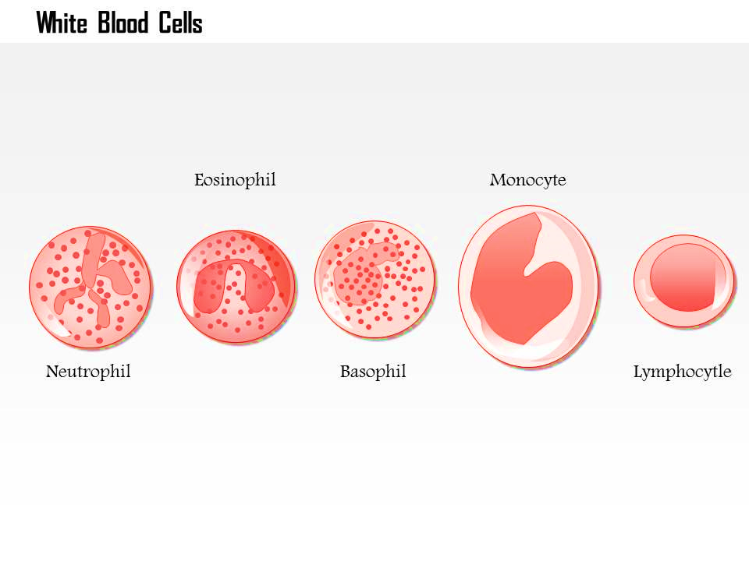
Thank you

